Slide 1
REPORT OF DASHBOARD OF CALL CENTER DATASET
COMPANY:PWC SWITZLAND
SUBMITTED BY :MANIKONDA SAI RATHNA

Slide 2
AGENDA
1.INTRODUCTION
.Problem statement
.Goals
.objective
2.Over Flow
3.Insight
4.Mode Reflection
5.Conclusion
6.Business Recommendaation

Slide 3
INTRODUCTION .Welcome to the power bi in data analytics . PwC Switzerland envisions strategic and coordinated company-wide implementation of new technology that impacts all employees and existing processes. This is a huge challenge. One we enthusiastically embrace. Because we know that digital transformation creates a new standard and motivates organizations to achieve a strong competitive advantage . If you’re into continually learning, and desire to excel and create impact by innovating, then Digital Services at PwC could be your world. You’ll increase your know-how, learn how to embed theoretical knowledge in you daily work, and work with diverse and creative teams to help drive innovative transformation for clients on their own paths to digital transformation GOALS “Work as a part of the analytics team working on the call data base model and its cost benefit analytics in these we create an visualization of data from the excel sheet easily formation

Slide 4
OBJECTIVE
Overall customer satisfaction
Overall calls answered/abandoned
Calls by time
Average speed of answer
Agent’s performance quadrant -> average handle time (talk duration) vs calls answered
Class | Group A | Group B
Class 1 | 82 | 95
Class 2 | 76 | 88
Class 3 | 84 | 90

Slide 5
PROBLEAM STATEMENT
Customers in the telecom industry are hard-earned: we don’t want to lose them
The retention department is here to get customers back in case of termination
Currently, we get in touch after they have terminated the contract, but this is reactionary: it would be better to know in advance who is at risk
We have done customer analysis with Excel: it has always ended in a dead-end
Group A
Group B
Group C

Slide 6
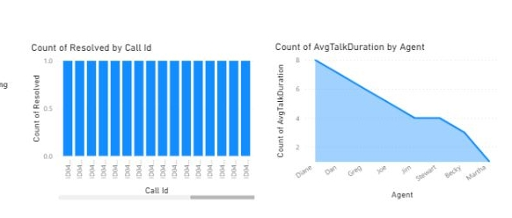
1.In general, a data type overflow error is when the data type used to store data was not large enough to hold the data. 2.Furthermore, some data types can only store numbers up to a certain size. An overflow error will be produced, for example, 3.if a data type is a single byte and the data to be stored is greater than 256 4. a programming error when too much memory is used on the call stack.
OVER FLOW

Slide 7
VISUAL REPRESENTATION OF CALL DATA BASE
DATA OF CALL LOG
AVERAGE TALK DURATION

Slide 8
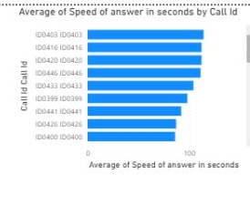
INSIGHT .Visual Analysis for the better understanding based on the call log data sets .Plot will make you understand call log which are issued to the traid

Slide 9
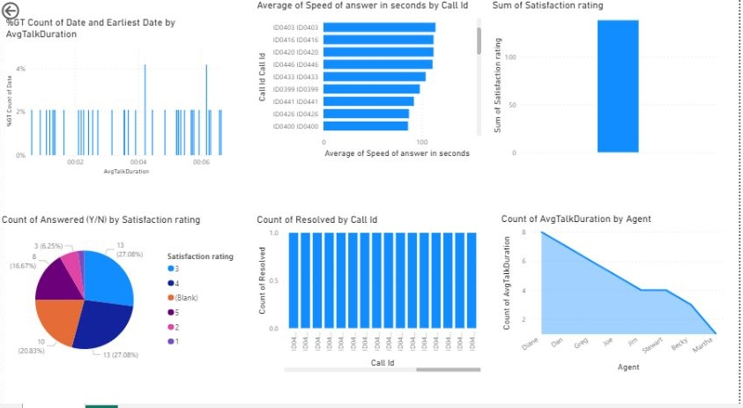

Slide 10
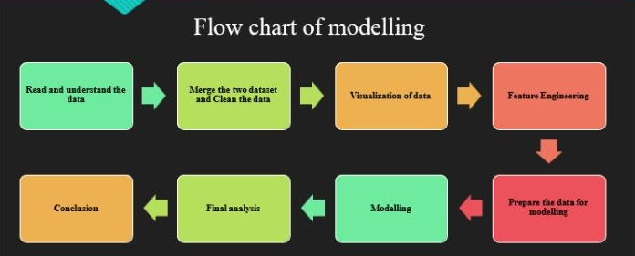
FLOW CHART OF THE MODELING

Slide 11

THANK YOU

Slide 12
Add a Slide Title - 6

